Slide 1
Quality
In project management, quality refers to the degree to which a project's deliverables meet the requirements, expectations, and standards defined by the stakeholders.
It is about ensuring that the product or service is fit for its intended use and aligns with agreed-upon specifications.
Key Aspects of Quality:
Conformance to Requirements: Ensuring deliverables meet defined standards and criteria.
Fitness for Use: Deliverables must serve their intended purpose effectively.
Stakeholder Satisfaction: Achieving the balance between stakeholder needs and project constraints.
Consistency: Delivering outputs reliably and without defects.

Slide 2
Example
In a mobile app development project, quality ensures:
The app's features match user requirements (e.g., intuitive navigation, secure payments).
The app runs smoothly without crashes (functional quality).
Stakeholders are satisfied with the final product.

Slide 3
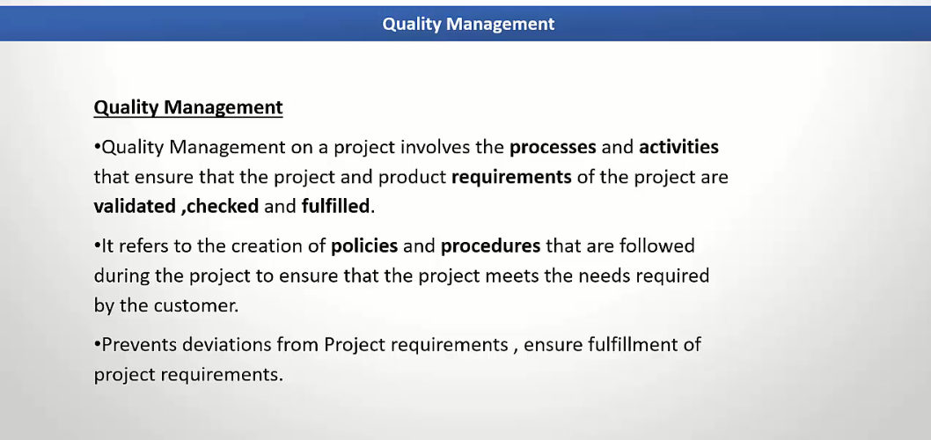

Slide 4
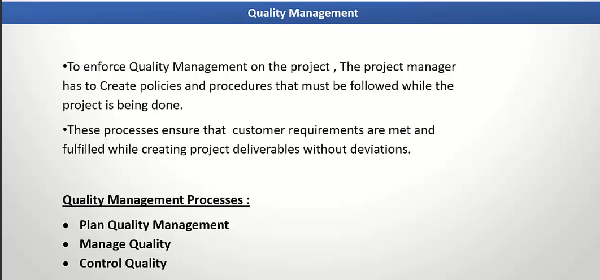

Slide 5
Plan Quality Management
This process focuses on identifying quality requirements and/or standards for the project and its deliverables and documenting how the project will comply with quality requirements.
Key Inputs:
Project charter
Project management plan
Stakeholder register
Risk register
Tools and Techniques:
Benchmarking
Cost-benefit analysis
Cause-and-effect diagrams
Flowcharts

Slide 6
Plan Quality Management
Outputs:
Quality management plan
Quality metrics
Project documents updates
Example:
Scenario: A software development project for a banking app requires compliance with ISO 9001 standards.
Application: During this process, the project team identifies that the app must be tested for usability, performance, and security. They create a quality management plan specifying metrics like "95% of test cases must pass," "response time < 2 seconds," and "no critical security vulnerabilities."

Slide 7
Manage Quality
This process involves translating the quality management plan into executable quality activities. It focuses on process improvement and ensuring quality standards are followed throughout the project lifecycle.
Key Inputs:
Quality management plan
Project documents
Organizational process assets
Tools and Techniques:
Quality audits
Process analysis
Root cause analysis

Slide 8
Manage Quality
Outputs:
Quality reports
Test and evaluation documents
Change requests
Example:
Scenario: The development team finds recurring issues in the testing phase of a healthcare software project.
Application: The team conducts a root cause analysis using a fishbone diagram and discovers that ambiguous requirements are leading to defects. A quality audit ensures all requirement specifications are rewritten in clear, measurable terms.

Slide 9
Control Quality
This process involves monitoring and recording the results of quality activities to assess performance and recommend necessary changes. It ensures that deliverables meet the acceptance criteria.
Key Inputs:
Quality metrics
Work performance data
Approved change requests
Tools and Techniques:
Inspection
Statistical sampling
Testing/product evaluations
Checklists

Slide 10
Control Quality
Outputs:
Verified deliverables
Work performance information
Quality control measurements
Example:
Scenario: A construction project involves building a high-rise.
Application: Inspectors use a checklist to verify that materials meet specifications, and statistical sampling ensures concrete strength exceeds required levels. Any non-conforming work is flagged for rework before final acceptance.

Slide 11
Practical Example: End-to-End Quality Management
Project: Launching a New Mobile App
Plan Quality Management:
Define requirements: "App must handle 10,000 concurrent users without performance degradation."
Document processes for usability and security testing.
Manage Quality:
Conduct code reviews and peer reviews during development.
Perform risk analysis to address vulnerabilities.
Control Quality:
Test the app against defined metrics like load time, error rates, and user satisfaction.
Use checklists during app launch to ensure compliance with all criteria.

Slide 12
Example of Quality in Software Development
Scenario: Developing an online banking application.
Plan Quality Management:
Set Standards: Define quality criteria such as:
Functionality: Features like fund transfers, balance inquiries, and bill payments must work without errors.
Performance: The application must handle 1,000 concurrent users with a response time of less than 2 seconds.
Security: Must comply with standards like PCI DSS for secure payment transactions.
Define Metrics:
Number of critical bugs found during testing should be zero.
Response time for user requests should be under 2 seconds.
Manage Quality:
Code Reviews: Developers perform peer code reviews to catch errors and ensure adherence to coding standards.
Automated Testing: Run automated test cases for unit tests, integration tests, and regression tests.
Continuous Integration: Use tools like Jenkins or GitHub Actions to build and test code with every change, ensuring issues are caught early.

Slide 13
Example of Quality in Software Development
Control Quality:
Functional Testing: QA team validates that all banking features work as expected (e.g., users can transfer funds).
Performance Testing: Stress-test the application using tools like JMeter to ensure it handles concurrent users without slowing down.
User Acceptance Testing (UAT): End-users verify the application meets their needs and expectations before deployment.
Outcome:
The application is free of critical bugs, meets all performance and security standards, and is successfully deployed to users.
Stakeholders are satisfied because the app delivers the intended functionality while ensuring security and reliability.

Slide 14
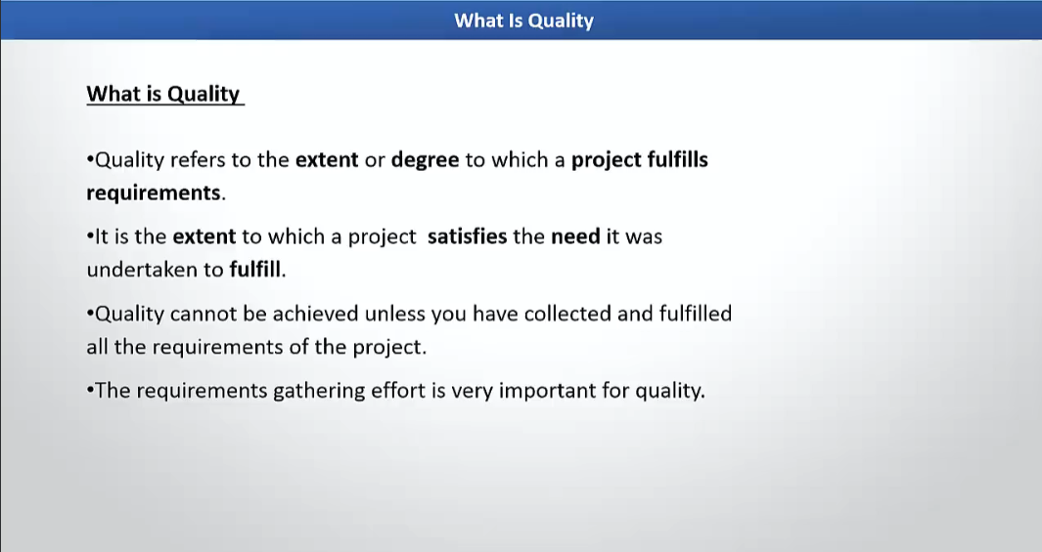

Slide 15
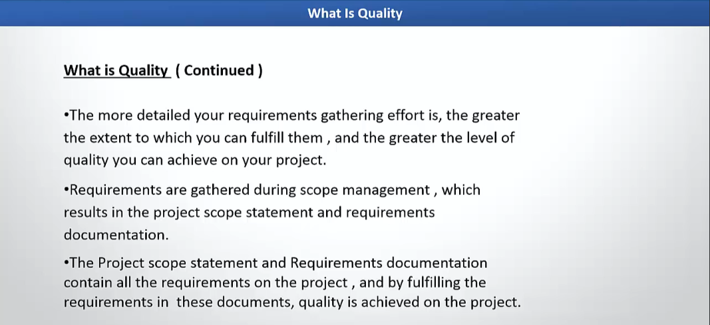

Slide 16
Quality vs Grade
Quality
Definition: The degree to which a set of inherent characteristics fulfill requirements.
Key Point: Quality is about conformance to requirements or specifications, irrespective of the grade of the product or service.
Examples:
High Quality: A budget smartphone that meets all its advertised features without defects.
Low Quality: A premium smartphone that has frequent software bugs or hardware issues.
Grade
Definition: A category or rank assigned to items having the same functional use but different technical characteristics.
Key Point: Grade is about the intended level of capability or sophistication. A high-grade product offers more features or capabilities compared to a low-grade product.
Examples:
High Grade: A flagship smartphone with advanced features like 5G, high-resolution camera, and premium materials.
Low Grade: A basic feature phone with limited functionality, such as calls and SMS only.

Slide 17
Relationship Between Quality and Grade
High Quality, Low Grade:
Example: A basic economy car that is reliable, fuel-efficient, and meets all safety standards.
Interpretation: Though the car lacks advanced features (low grade), it performs as expected (high quality).
High Quality, High Grade:
Example: A luxury car with advanced features, excellent performance, and no defects.
Interpretation: It meets high expectations both in terms of features and quality.
Low Quality, Low Grade:
Example: A budget hotel with poor maintenance and subpar service.
Interpretation: The hotel not only lacks premium features but also fails to meet basic standards.
Low Quality, High Grade:
Example: A luxury hotel with beautiful amenities but unclean rooms and poor service.
Interpretation: Despite having high-end features (high grade), it fails to meet expected standards (low quality).

Slide 18
PMBOK Perspective on Quality vs. Grade
Both Concepts Should Be Addressed:
Quality: Ensuring the product or service meets the stated requirements and satisfies customer needs.
Grade: Choosing the right level of features or sophistication to align with project objectives and customer expectations.
Low Quality is Always a Problem:
Low quality leads to dissatisfaction and project failure, regardless of the grade.
PMBOK emphasizes avoiding low quality by adhering to quality management processes.
Low Grade is Acceptable When Appropriate:
A low-grade product can be acceptable if it meets requirements and expectations for its category.
For example, a project to deliver a basic solution for a rural area may prioritize low cost and functionality over high-grade features.

Slide 19
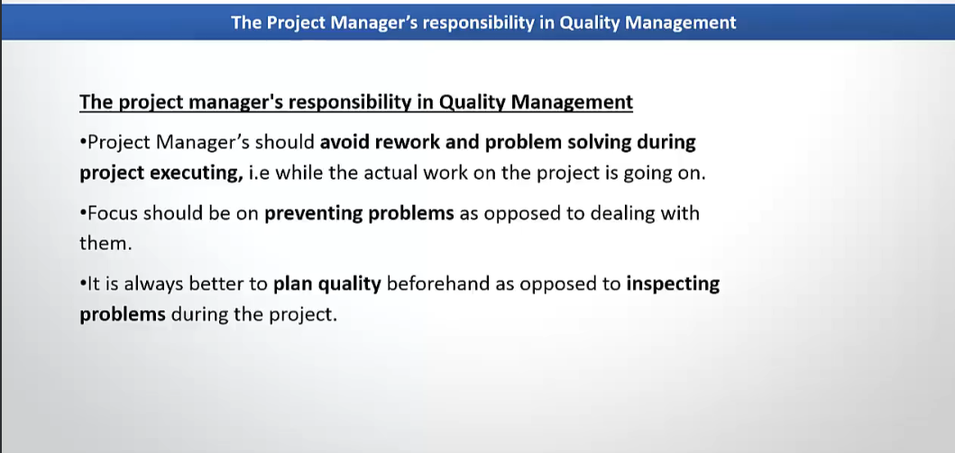

Slide 20
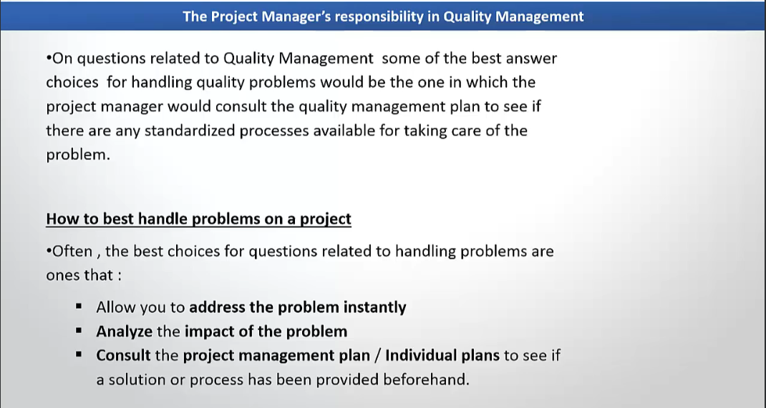

Slide 21
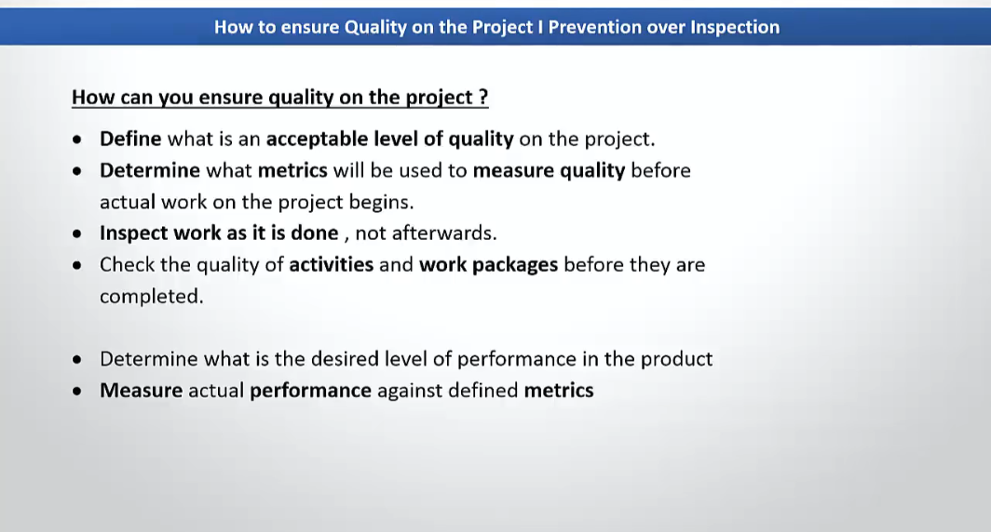

Slide 22
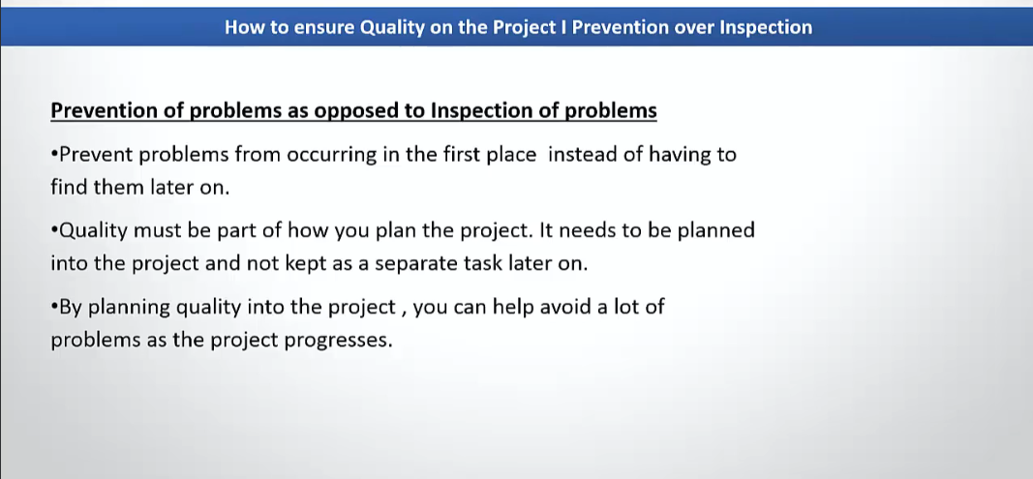

Slide 23
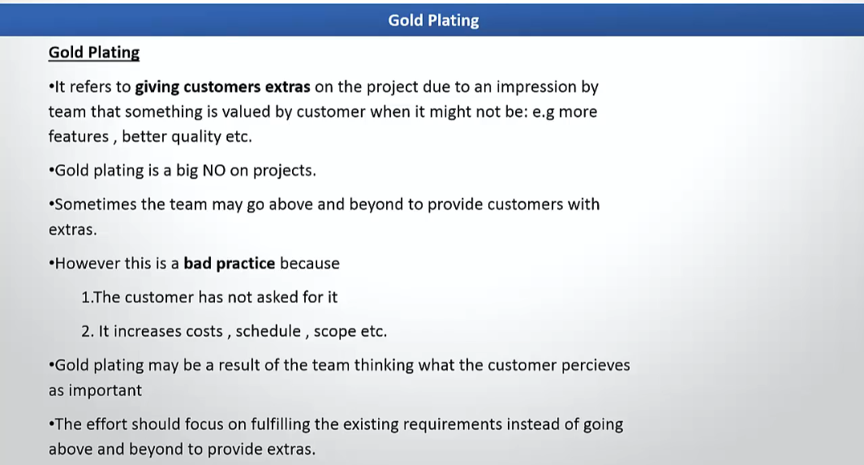

Slide 24
Marginal Analysis
Marginal analysis is a decision-making process used to determine the cost-effectiveness of adding one more unit of effort or resource versus the incremental benefit it provides.
The goal is to identify the point where the marginal cost equals the marginal benefit to maximize efficiency without unnecessary resource expenditure.
Application in Project Quality Management:
It is often applied in determining the level of quality testing, inspection, or process improvement needed to balance cost and benefits.
Example:
In a software development project, a project manager uses marginal analysis to decide the extent of testing needed:
Scenario: Adding more test cases improves quality but increases costs and delays delivery.
Decision: The project manager evaluates whether the benefit of detecting additional defects (marginal benefit) justifies the additional cost of resources (marginal cost). If additional testing is unlikely to uncover critical defects, the manager may stop testing at that point.

Slide 25
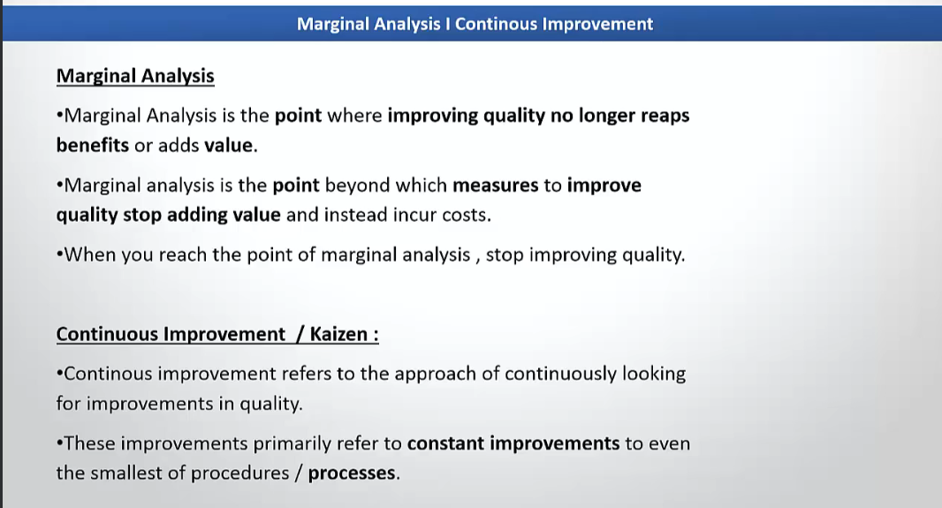

Slide 26
Just-In-Time (JIT)
JIT emphasizes delivering the right resources, materials, or information at the right time, minimizing waste, and enhancing quality by improving focus and efficiency.
Key Principles of JIT in Project Quality Management
Minimizing Waste:
Reducing unnecessary inventory, tasks, or rework.
Optimizing processes to eliminate wasteful activities.
Focus on Quality:
Producing only what is needed when it is needed to prevent defects or overproduction.
Encourages the team to pay attention to quality at every step, as there is little buffer for errors.
Efficiency in Processes:
Streamlined workflows to reduce delays.
Timely delivery of inputs ensures smooth operations and better output quality.

Slide 27
Example of JIT in Project Quality Management
Scenario: Manufacturing Project
A project involves assembling high-quality electronic devices.
Implementation of JIT:
Components (e.g., circuit boards, sensors) are delivered to the assembly line just before they are needed.
This reduces storage costs, prevents damage to materials, and ensures the team works only with the latest and correct specifications.
Inspection and testing are done immediately after each assembly step, ensuring defects are caught early.
Benefits:
Reduced inventory costs.
Early detection of quality issues prevents large-scale rework.
Increased focus on quality during each step of the process.

Slide 28
Scenario: Software Development Project
A team is building a mobile application using Agile methodology.
Implementation of JIT:
User stories and tasks are defined and assigned just before the sprint starts.
Developers receive requirements "just in time" to prevent working on outdated information.
Code quality checks (e.g., peer reviews or automated tests) are conducted as soon as the code is written, ensuring bugs are identified early.

Slide 29
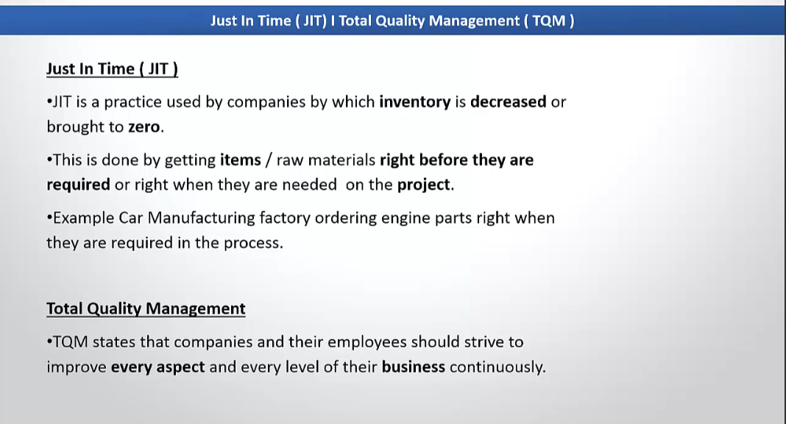

Slide 30
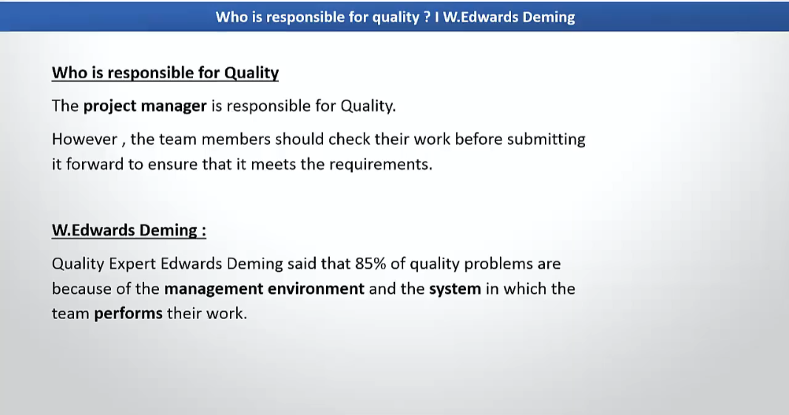

Slide 31
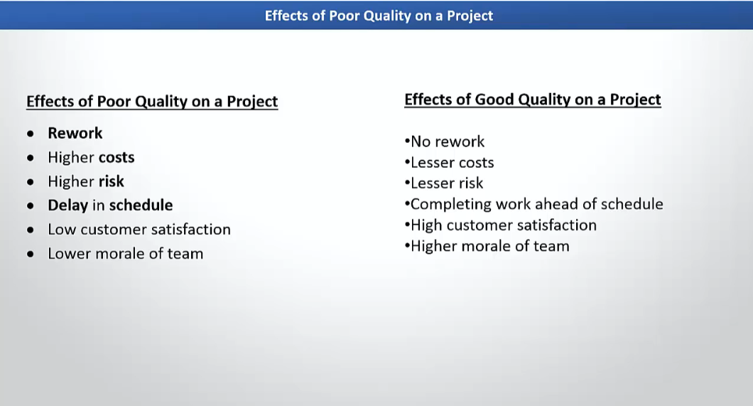

Slide 32
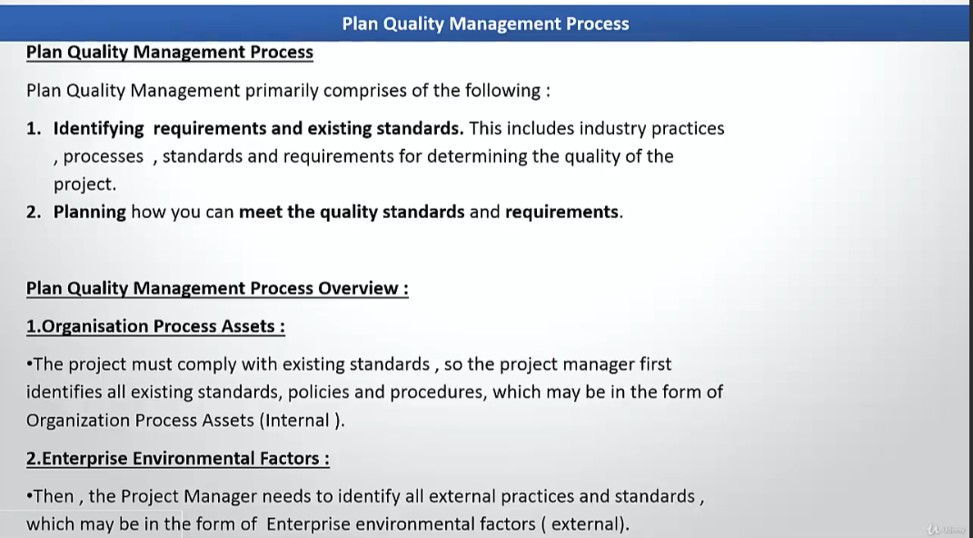

Slide 33
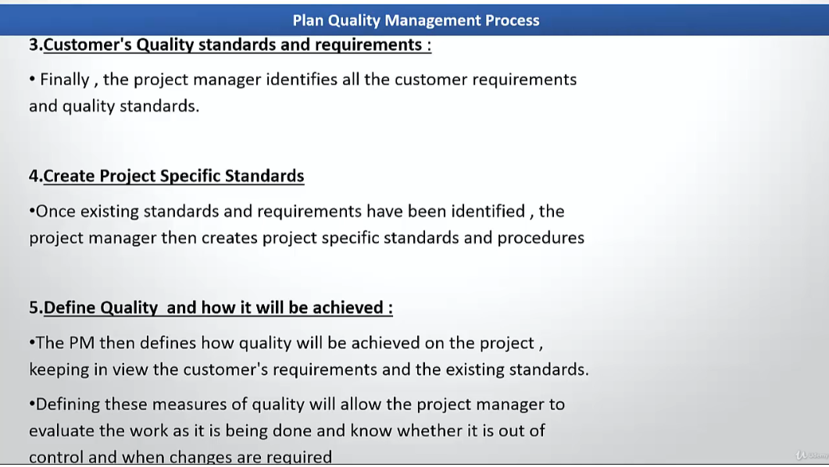

Slide 34
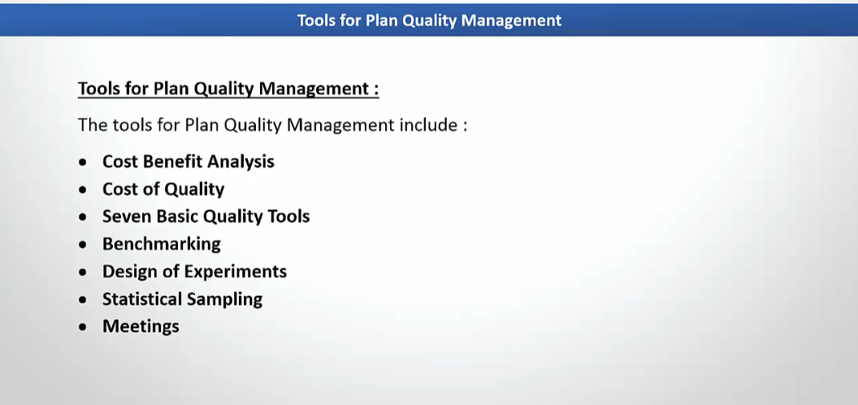

Slide 35
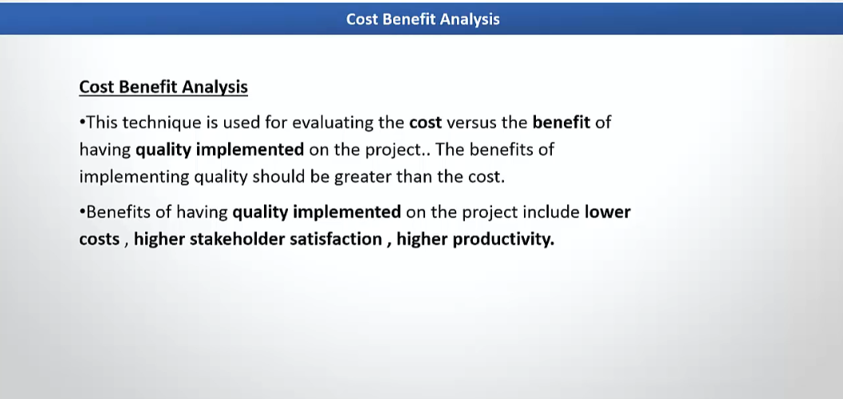

Slide 36
Cost Benefit Analysis
It involves comparing the costs of implementing quality measures to the benefits gained to ensure resources are used efficiently while delivering optimal project value.
Purpose of Cost-Benefit Analysis in Quality Management
Optimize Resource Allocation: Ensures the right balance between quality improvements and cost.
Decision-Making: Assists in determining whether a quality initiative is worth pursuing.
Risk Mitigation: Reduces costs associated with defects, rework, or customer dissatisfaction.
Aligning Objectives: Ensures quality efforts meet stakeholder expectations and provide value.

Slide 37
Steps to Perform Cost-Benefit Analysis
Identify Costs: Include direct costs (e.g., materials, tools) and indirect costs (e.g., training, resource time).
Estimate Benefits: Consider tangible benefits (e.g., reduced defects) and intangible benefits (e.g., customer satisfaction).
Calculate Net Benefit: Subtract total costs from total benefits.
Decision: Choose initiatives where benefits outweigh costs.

Slide 38
Example
Scenario: Software Development Project
A team is developing a financial application.
Problem: Frequent bugs in the code lead to rework and delayed releases.
Proposed Quality Initiative:
Invest in automated testing tools costing $5,000.
Allocate $3,000 for developer training.
Estimated Benefits:
Reduced rework saves 200 developer hours at $50/hour = $10,000.
Shortened time-to-market increases client satisfaction, valued at $5,000.

Slide 39
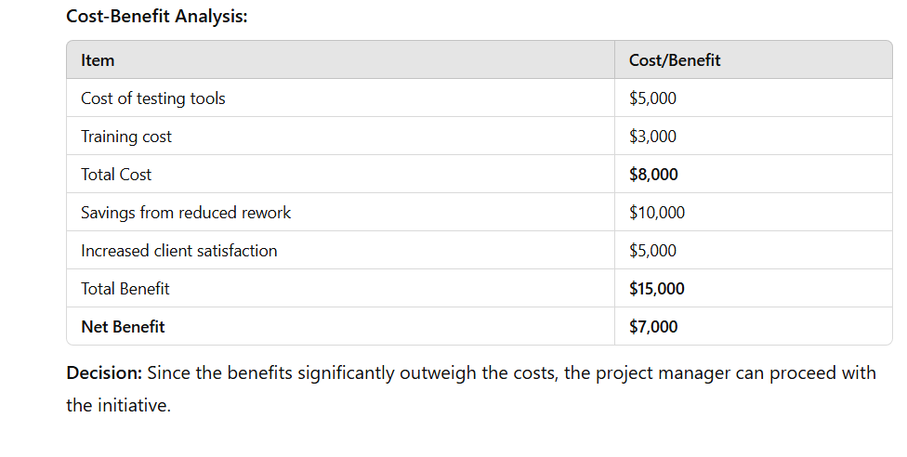
Example

Slide 40
Statistical Sampling
It involves selecting a subset of items from a population for inspection or testing to make inferences about the entire population's quality.
This method is particularly useful when inspecting every item is impractical due to time,
Types of Sampling Techniques
Random Sampling: Every item has an equal chance of being selected.
Stratified Sampling: The population is divided into subgroups (strata), and samples are taken from each group.
Systematic Sampling: Items are selected at regular intervals (e.g., every 10th item).
Judgmental Sampling: Items are chosen based on expert judgment.

Slide 41
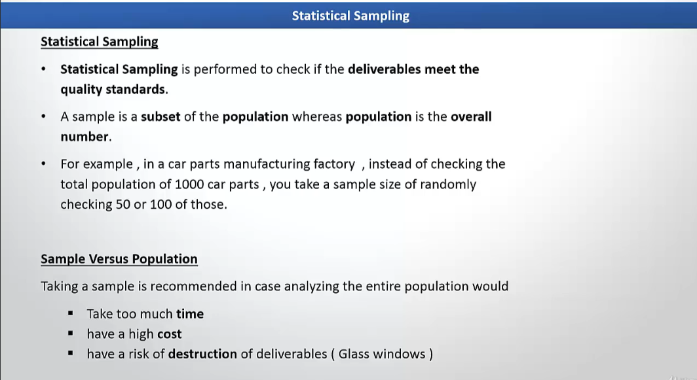

Slide 42
Benchmarking
It involves comparing the project’s processes, performance, and practices to those of industry leaders or best-in-class organizations to identify opportunities for improvement.
Purpose of Benchmarking in Project Quality Management
Identify Best Practices: Helps discover industry best practices that can improve project quality.
Continuous Improvement: Supports efforts to enhance project performance by comparing current practices with top performers.
Set Quality Standards: Establishes measurable targets for quality based on the performance of leaders in the field.
Problem-Solving: Provides insights into how similar problems were solved by others, enabling faster and more effective solutions.

Slide 43
Benchmarking
Types of Benchmarking
Internal Benchmarking: Comparing processes or performance within the same organization (e.g., comparing different departments or teams).
Competitive Benchmarking: Comparing processes with direct competitors or other organizations within the same industry.
Functional Benchmarking: Comparing processes with organizations that perform similar functions but may not be direct competitors (e.g., comparing a project’s quality assurance practices with those of a non-competing company in the same field).
Generic Benchmarking: Comparing processes or performance across different industries to discover innovative practices.

Slide 44
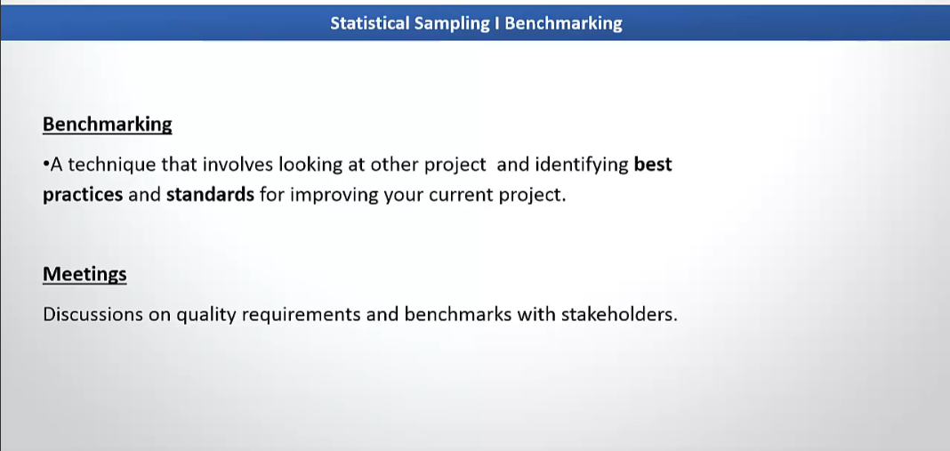

Slide 45
Design of Experiment (DOE)
In Project Quality Management, DOE is used to optimize processes, enhance quality, and drive improvements by systematically testing variables and analyzing their impact on project performance.
Purpose of Design of Experiment (DOE) in Project Quality Management
Identify Key Variables: Helps identify which factors have the most significant impact on quality outcomes.
Optimize Processes: Provides insights on how to adjust variables to improve project quality.
Reduce Variation: Identifies the source of process variation and allows for its control to ensure consistent outcomes.
Improve Decision Making: Provides data-driven insights to make informed decisions about process improvements and optimizations.

Slide 46
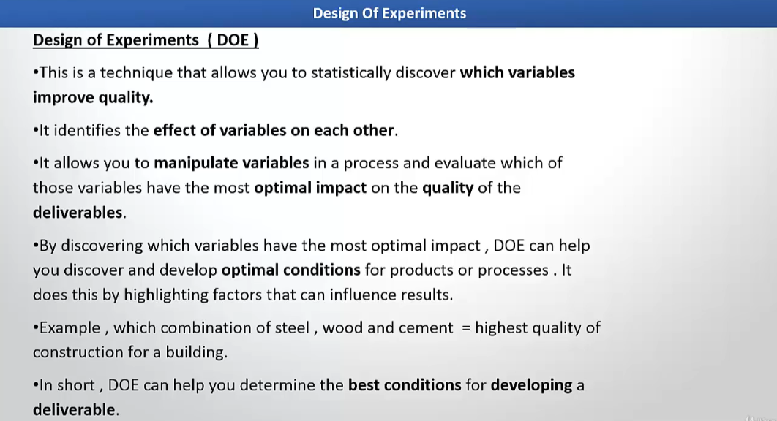

Slide 47
Cost of Quality (COQ)
The Cost of Quality (COQ) is a concept used in Project Quality Management that refers to the total cost incurred to ensure that a project or product meets the required quality standards. The cost of quality is typically divided into two main categories:
Cost of Conformance
Cost of Non-Conformance
COQ helps project managers to assess the financial impact of the quality management processes and understand the relationship between quality efforts and the costs involved.
By evaluating COQ, project managers can make more informed decisions to balance the investment in quality with the potential cost of poor quality.

Slide 48
Cost of Quality (COQ)
Cost of Conformance
The Cost of Conformance refers to the costs incurred to ensure that the project or product meets quality standards.
This includes all the efforts put into preventing defects and ensuring that the project is executed as planned, meeting the required quality expectations.
There are two subcategories within the Cost of Conformance:
Prevention Costs: Costs associated with activities that prevent defects from occurring.
Appraisal Costs: Costs related to measuring and monitoring quality to ensure that defects do not occur.

Slide 49
Cost of Quality (COQ)
Examples of Cost of Conformance:
Prevention Costs:
Training and Development: Investing in training the project team on quality standards and best practices.
Quality Planning: Developing quality management plans, processes, and procedures to ensure the project meets quality standards.
Process Improvement: Implementing processes that ensure quality control and assurance, such as adopting lean practices to prevent waste.
Example: A construction project spends money on training workers to follow specific construction standards, ensuring no future errors in building quality.
Appraisal Costs:
Inspection and Testing: Costs of performing inspections, testing materials, and validating that products meet the specified quality criteria.
Quality Audits: Conducting quality audits to verify that the project follows the defined quality management processes.
Example: In a software development project, the team conducts regular code reviews, peer testing, and unit tests to ensure the software meets all functional requirements.

Slide 50
Cost of Quality (COQ)
Cost of Non-Conformance
The Cost of Non-Conformance refers to the costs incurred when defects or quality issues occur.
These costs arise when the project fails to meet the required quality standards, leading to the need for corrective actions and rework.
The Cost of Non-Conformance includes both internal costs (those incurred before the product or service is delivered to the customer) and external costs (those incurred after the product or service has been delivered to the customer).
There are two subcategories within the Cost of Non-Conformance:
Internal Failure Costs: Costs associated with defects found before the product is delivered to the customer.
External Failure Costs: Costs associated with defects found after the product is delivered to the customer.

Slide 51
Cost of Quality (COQ)
Examples of Cost of Non-Conformance:
Internal Failure Costs:
Rework: Costs of fixing defects found during the project execution phase, such as reassembling parts or rewriting code.
Scrap: Costs related to materials or components that are discarded due to defects.
Example: In a manufacturing project, defective parts produced during the assembly process are identified and need to be reworked or scrapped, resulting in additional labor and material costs.
External Failure Costs:
Warranty Costs: Costs incurred when a product fails after delivery and requires replacement or repair under warranty.
Customer Dissatisfaction: Costs of handling complaints and addressing customer dissatisfaction due to quality issues.
Liability Claims: Legal costs associated with claims due to poor quality, such as lawsuits for safety violations or defective products.
Example: A software company releases a product with bugs, and after deployment, customers report the issues, requiring a patch or update to fix the defects. The company also faces reputational damage and loss of customer trust, resulting in additional costs for support and corrective measures.

Slide 52
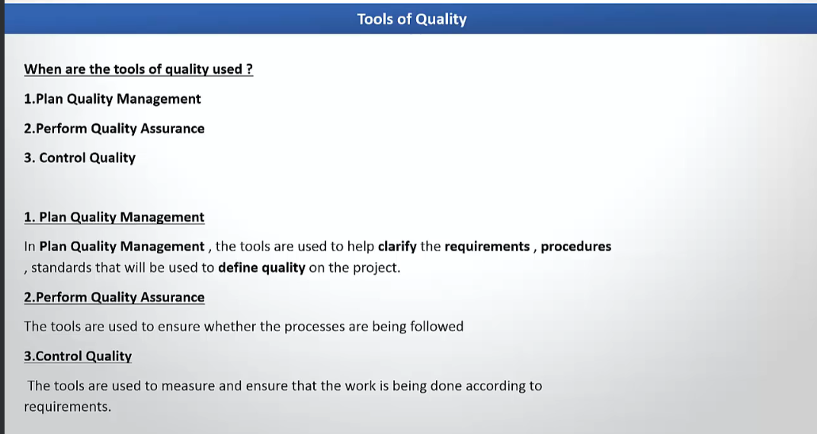

Slide 53
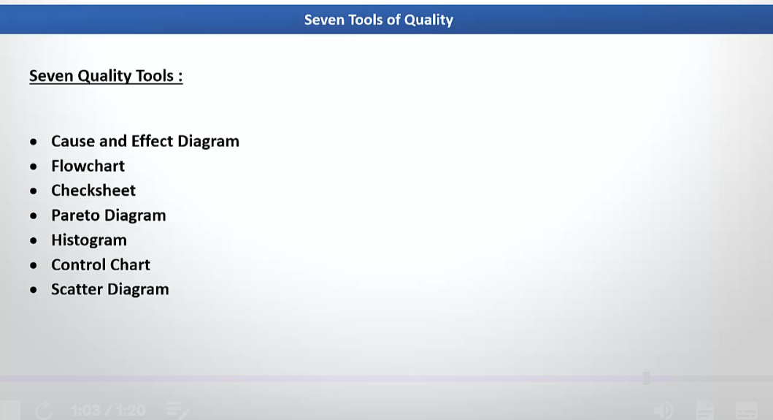

Slide 54
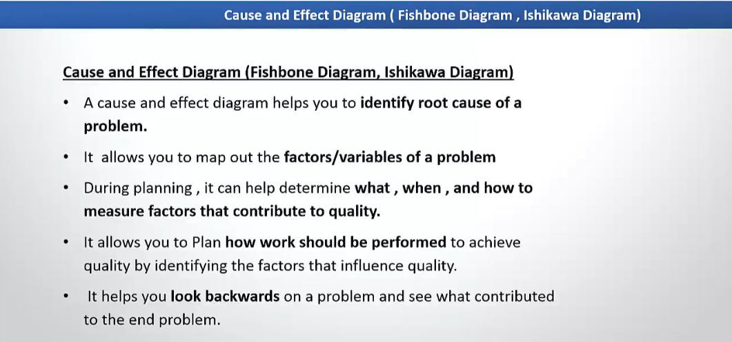

Slide 55
Cause and Effect
A Cause and Effect Diagram, also known as a Fishbone Diagram or Ishikawa Diagram, is a tool used in project quality management to identify and analyze the causes of a specific problem or effect.
It helps teams in understanding the root causes of issues, ensuring that corrective actions can be taken to improve project quality. This tool is aligned with PMBOK (Project Management Body of Knowledge), particularly in the Quality Management knowledge area.
Components of a Cause and Effect Diagram:
Effect (Problem): This is placed at the "head" or end of the diagram and represents the issue or problem that needs to be solved.
Major Categories of Causes: These are typically the "bones" of the fish, categorized into various sources of potential causes. The common categories include:
People: Involves the human factors (skills, communication, training, etc.).
Process: Refers to the workflow, procedures, or steps in the process.
Materials: Concerns the raw materials, resources, or information used in the project.
Machines/Equipment: Refers to the tools, technology, or equipment involved.
Measurement: Deals with how performance or quality is measured.
Environment: Concerns the external environment that can affect the project.
Minor Causes: These are the smaller causes that contribute to the main categories and are added as sub-branches to the major categories.

Slide 56
Cause and Effect
Example of Cause and Effect Diagram:
Imagine a project that has a quality issue where the deliverables are not meeting the required standards (effect). The team could use a Cause and Effect Diagram to identify potential causes.
Effect:
Deliverables Not Meeting Quality Standards
Categories of Causes:
People:
Lack of training
Inadequate communication
Low team morale
Process:
Unclear project requirements
Inefficient work processes
Inadequate testing procedures
Materials:
Incorrect specifications
Poor quality raw materials
Lack of updated documentation
Machines/Equipment:
Outdated software tools
Inconsistent hardware configurations
Lack of access to required technology
Measurement:
Inaccurate data collection
Inconsistent performance metrics
Lack of clear quality standards
Environment:
Unfavorable project environment (e.g., unstable market conditions)
External regulatory changes

Slide 57
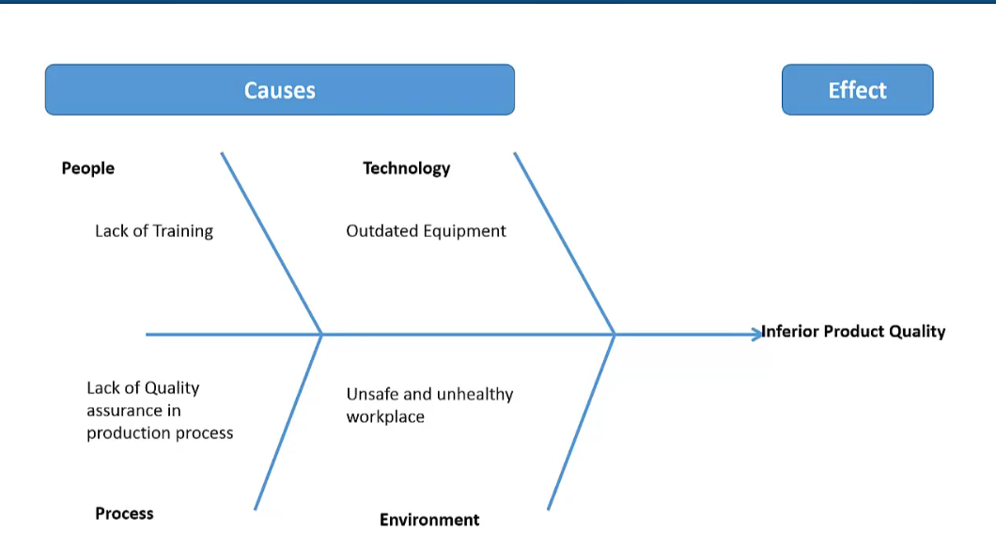

Slide 58
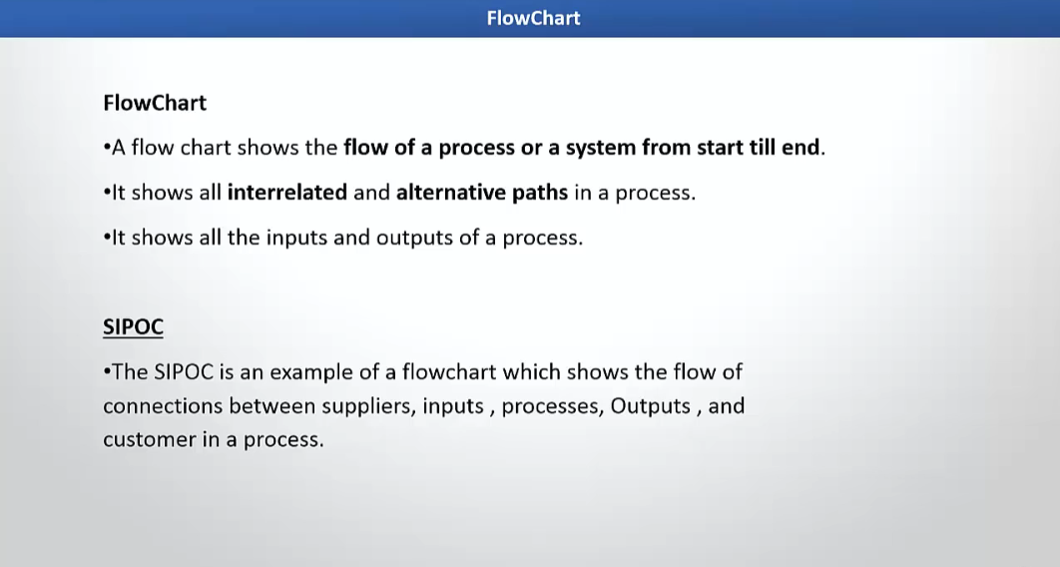

Slide 59
SIPOC
S = Suppliers: Who provides the inputs needed for the process?
I = Inputs: What materials, information, or resources are needed to perform the process?
P = Process: What are the major steps or activities that take place to convert inputs into outputs?
O = Outputs: What are the results or products of the process?
C = Customers: Who receives the outputs of the process?

Slide 60
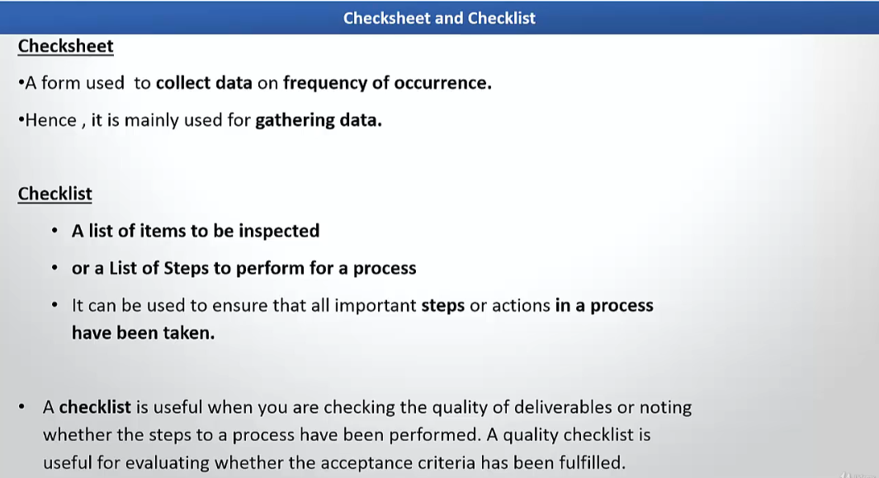

Slide 61
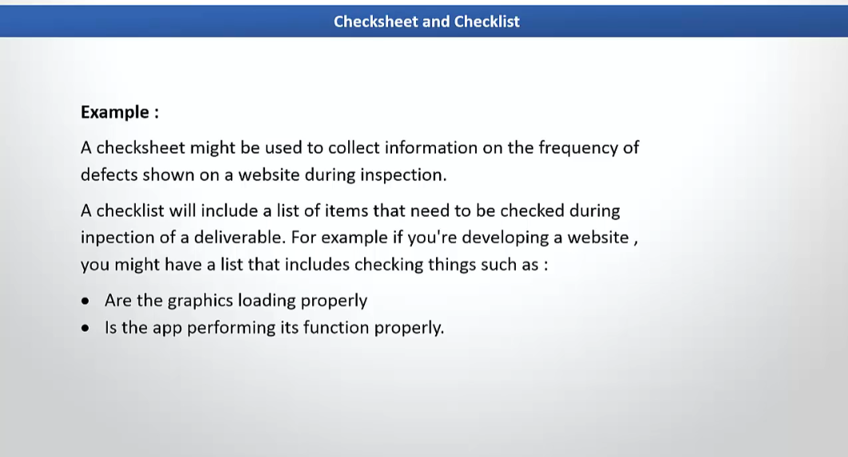

Slide 62
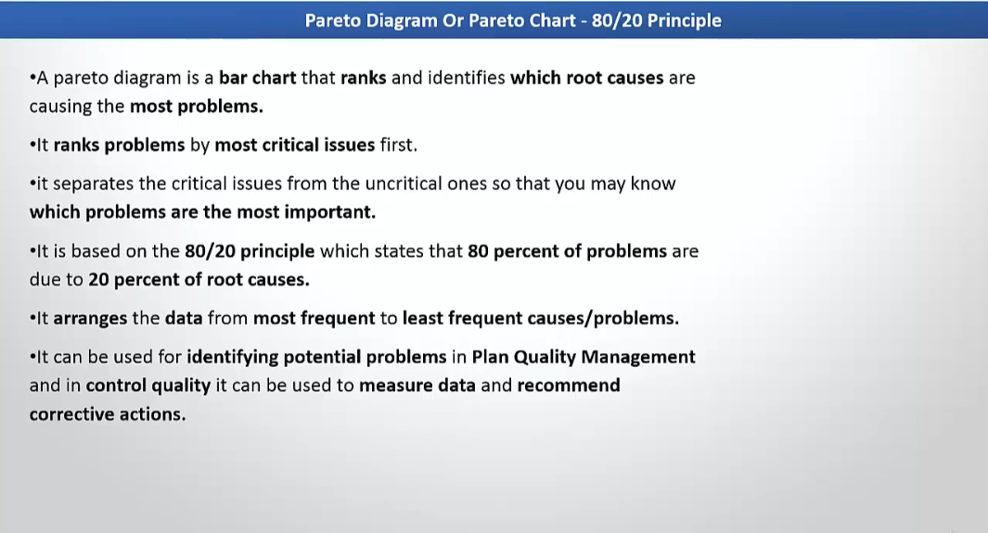

Slide 63
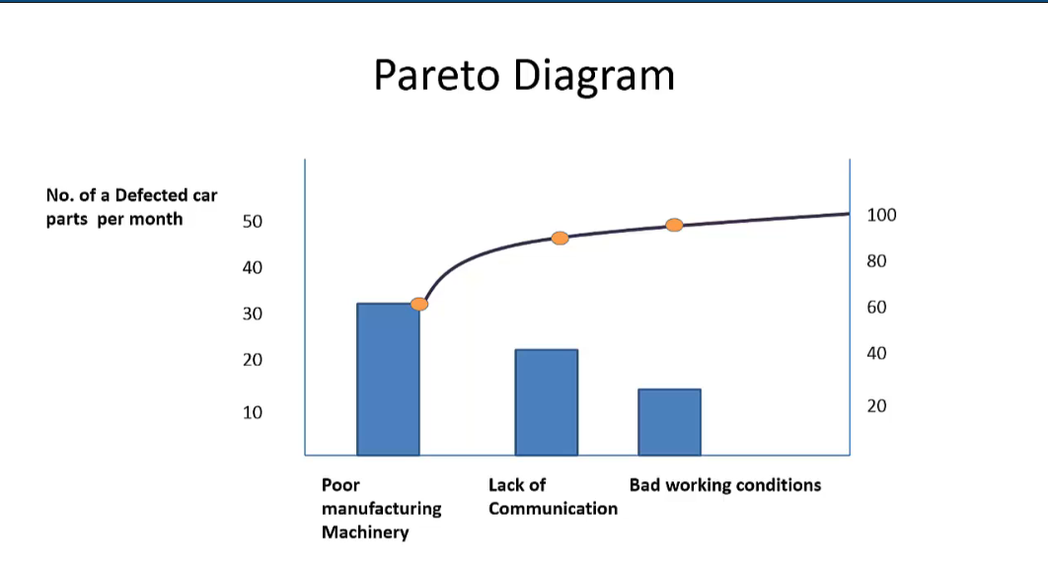

Slide 64
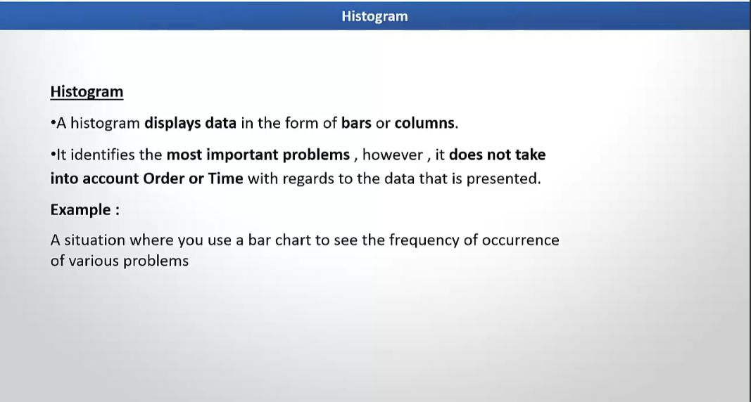

Slide 65
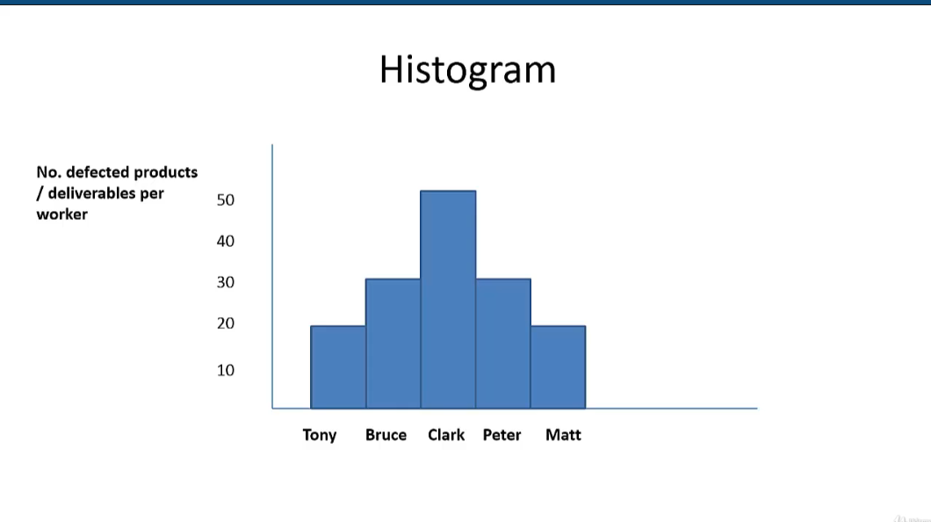

Slide 66
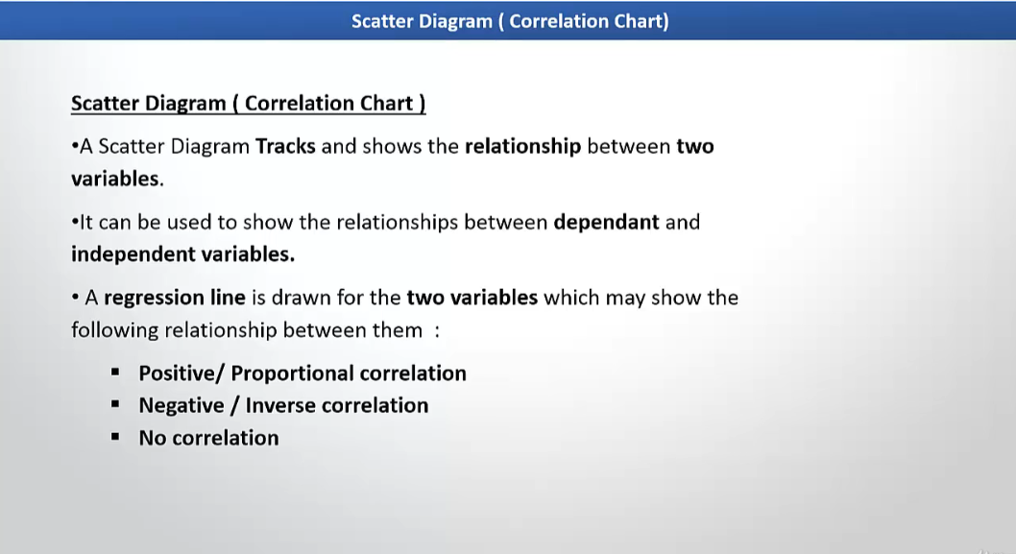

Slide 67
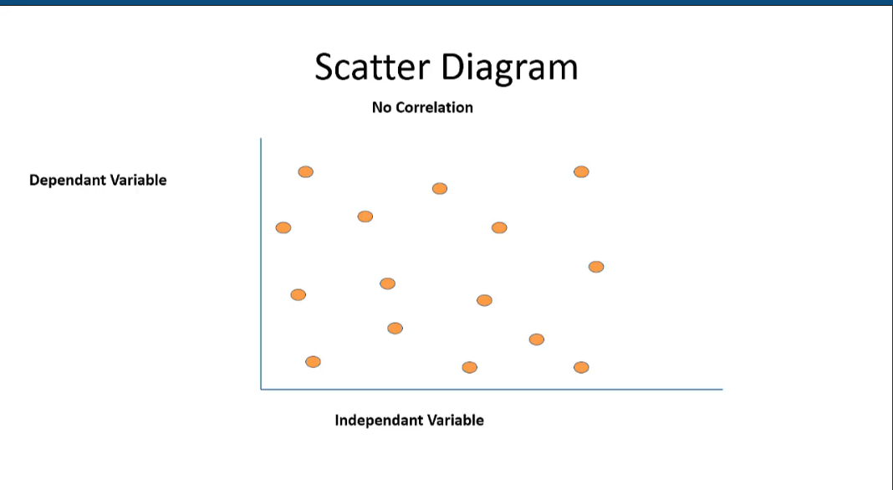

Slide 68
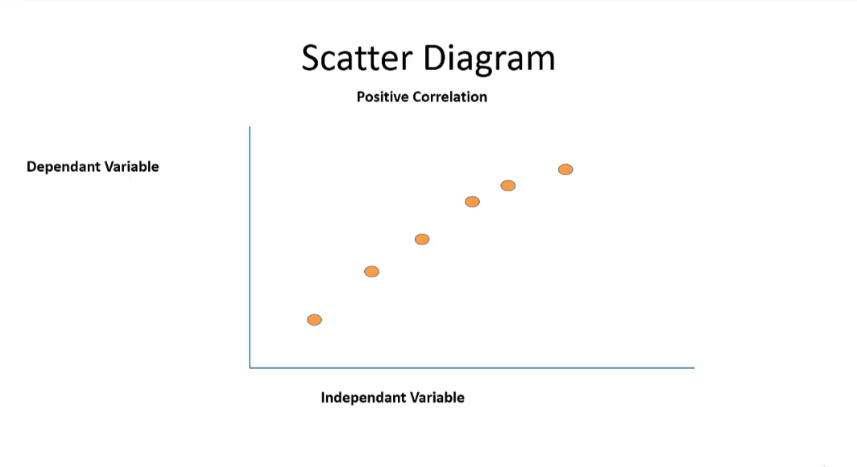

Slide 69
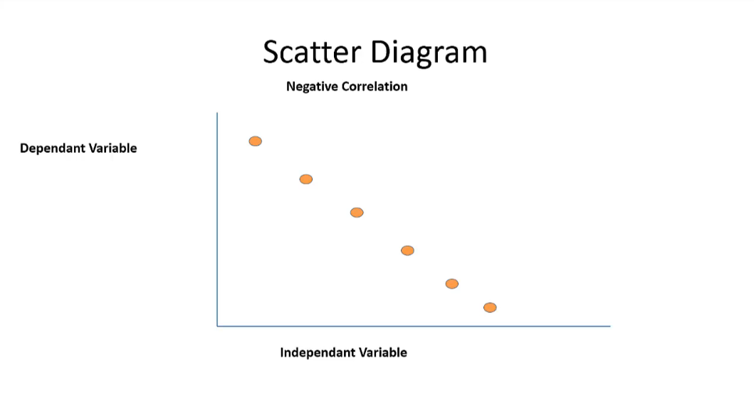

Slide 70
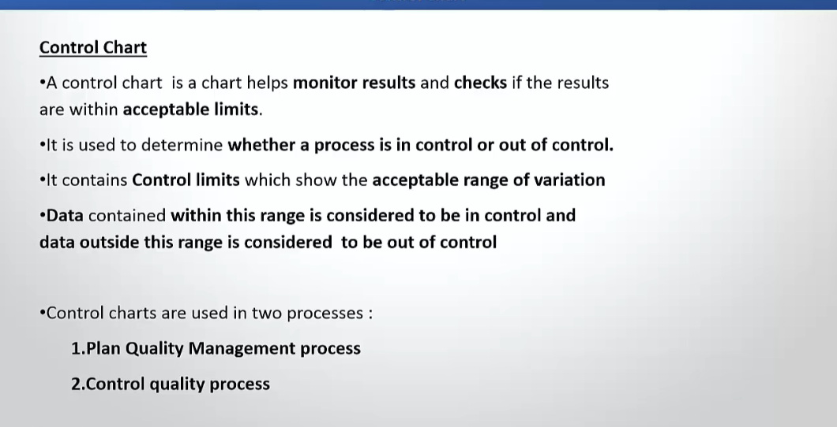

Slide 71
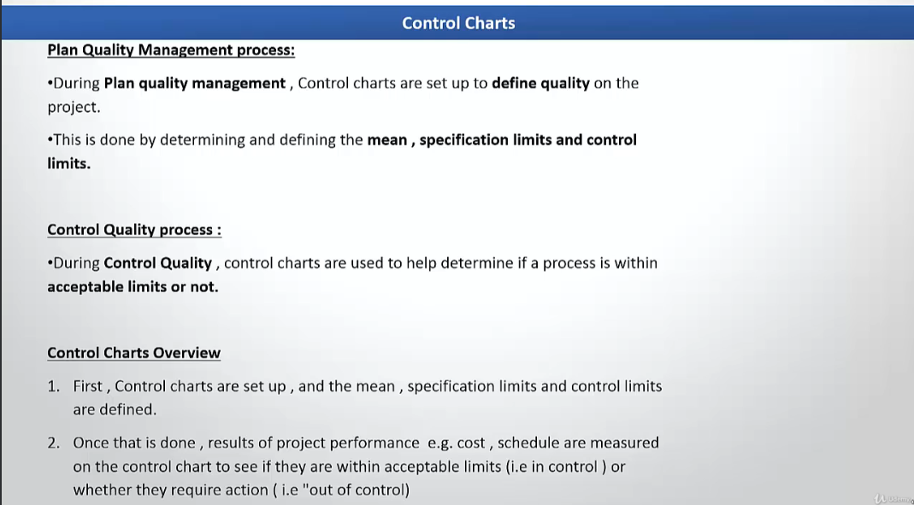

Slide 72
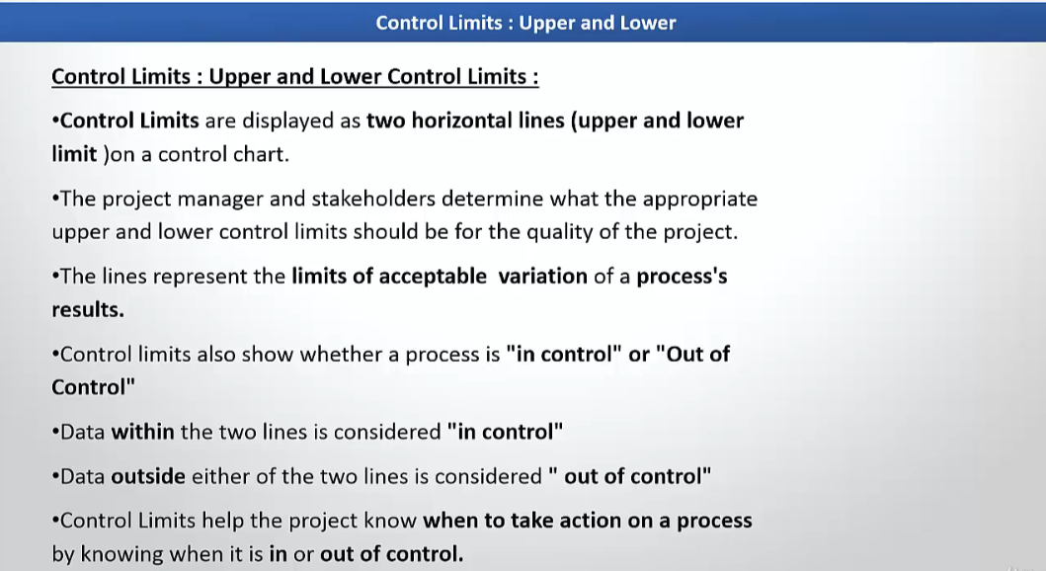

Slide 73
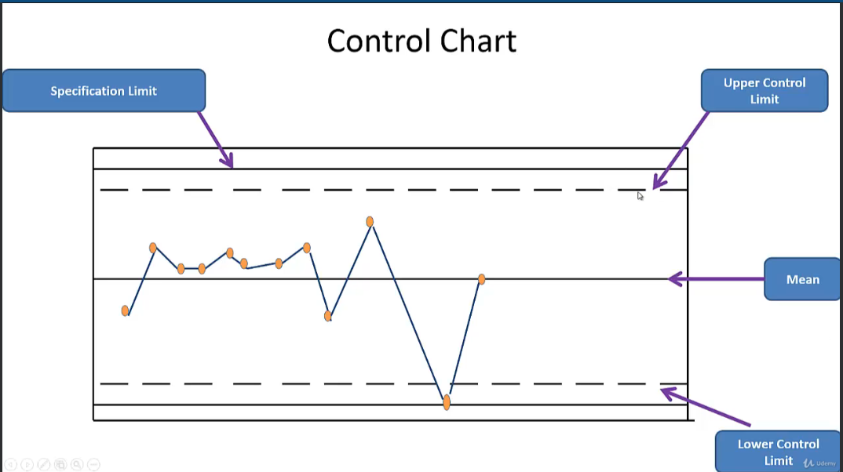

Slide 74
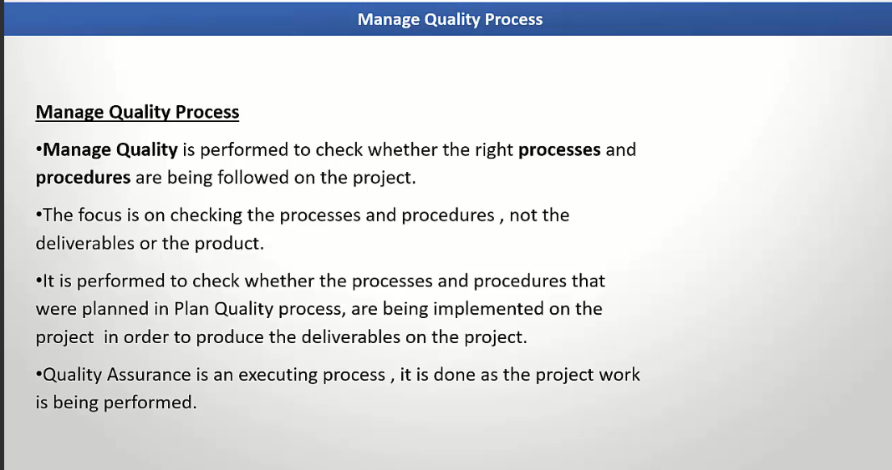

Slide 75
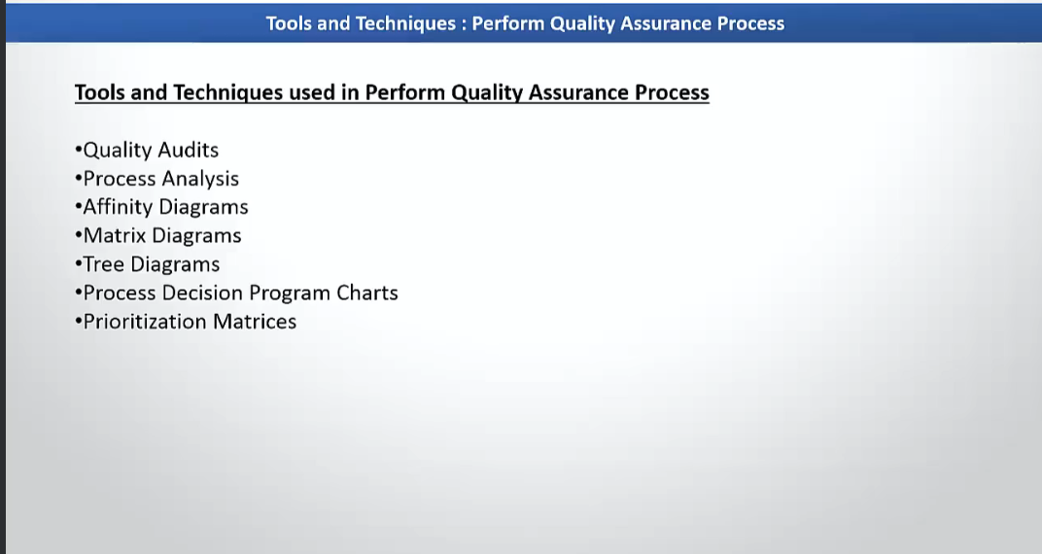

Slide 76
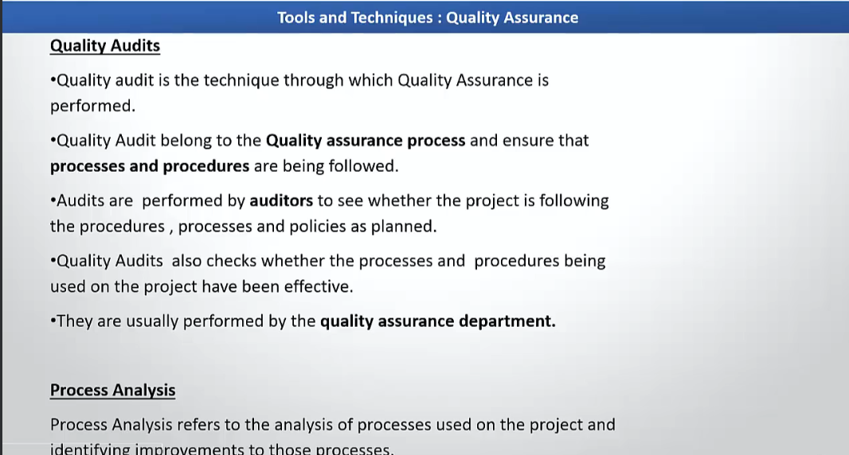

Slide 77
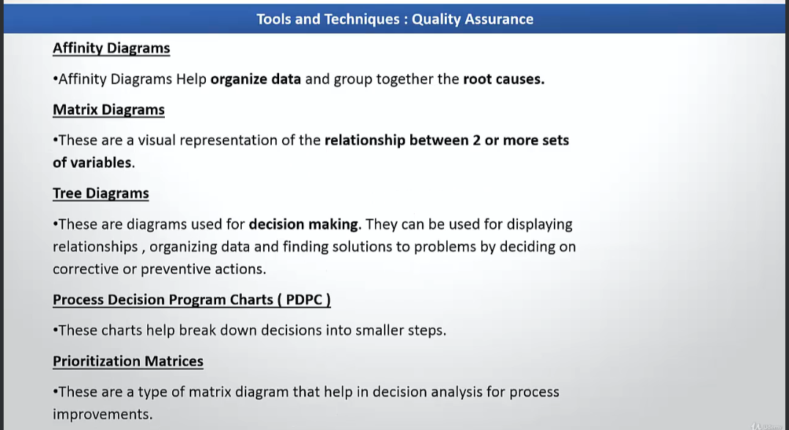

Slide 78
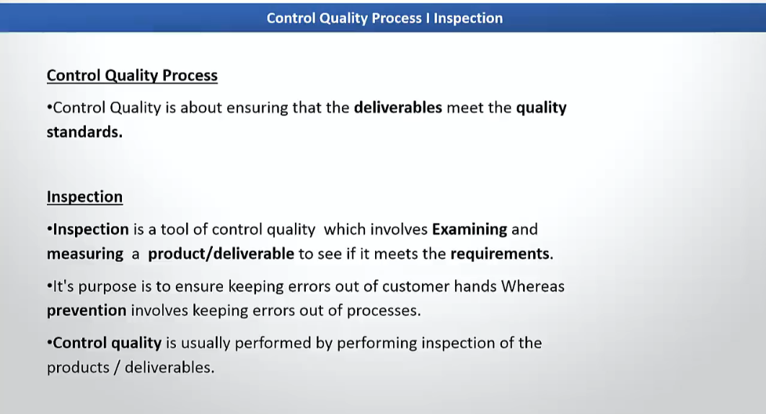

Slide 79
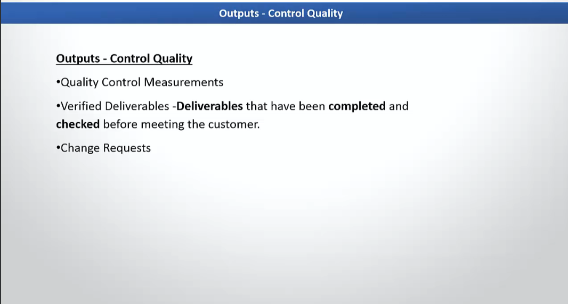

Slide 80
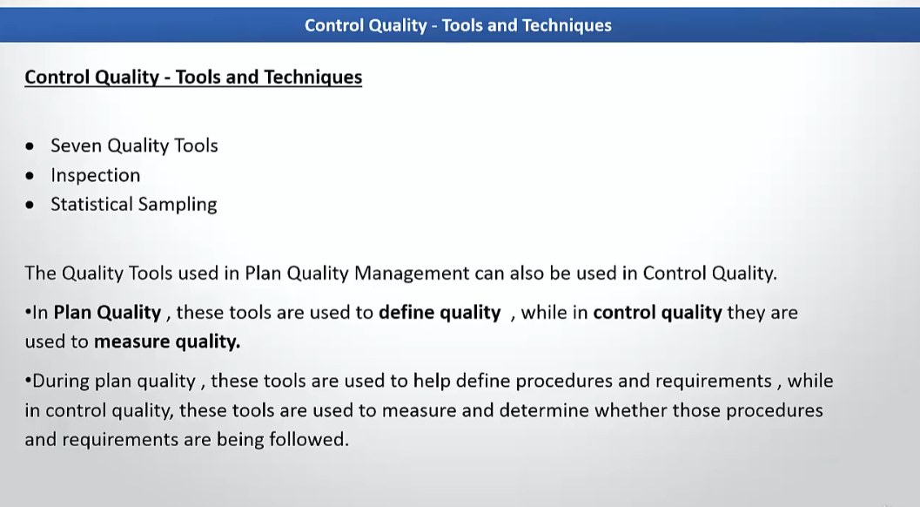

Slide 81
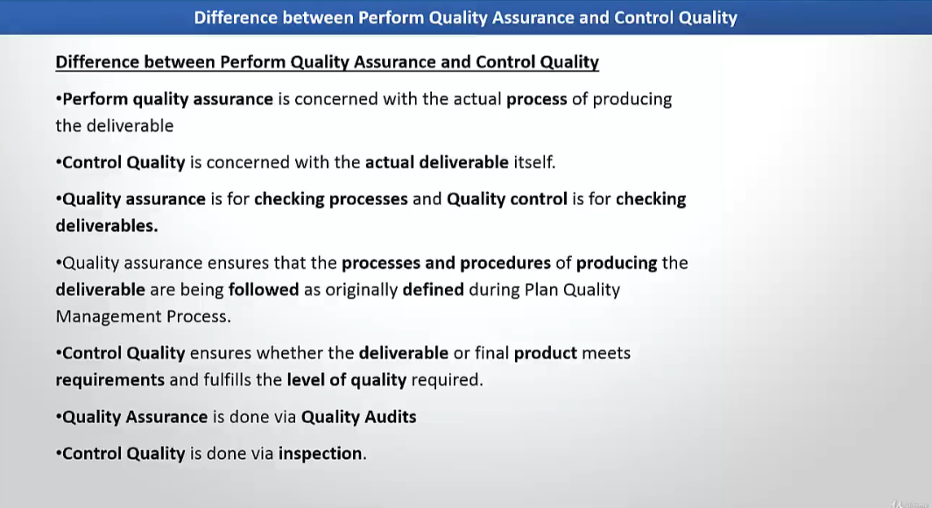

Slide 82
